Slide 1
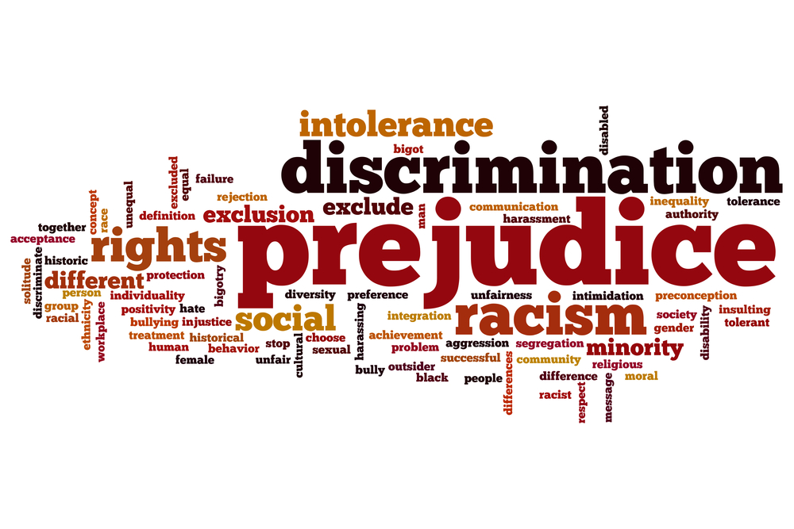
Social Injustice
How do issues in social injustice apply to sports?

Slide 2
Note Taking
You must make notes by writing day key pieces of information/facts.
These will be useful for future assignments and tests.
There is no option to sit an do nothing and I am not putting the notes on my website.
Failure to meet classroom responsibilities will mean no PE for you tomorrow!

Slide 3
Social Justice
Social justice is the equal distribution of resources and opportunities, in which outside factors that categorize people are irrelevant.
What are some factors that we use to categorize people?
Make a list of at least three things.

Slide 4
Factors that categorize
Factors
Factors
Sex / Gender
Race
Wealth
Sexual orientation
Gender identity
Age
Religion
Dress
Profession
Appearance
Intelligence
Ability / Disability
Social standing
Others?

Slide 5
What is social injustice?
Social injustice occurs when an individual or group is treated unfairly.
It is a situation in which the rights of a person or a group of people are ignored.
If an action or decision causes harm to society or the environment then it would be considered to be socially irresponsible.

Slide 6
Social Responsibility
Ethics is the study of what is morally right or wrong.
Social responsibility is an ethical theory, in which individuals are accountable for fulfilling their civic duty; the actions of an individual must benefit the whole of society.
In this way, social fairness is believed (by most) to be in the “right”, but more frequently than not this “fairness” is absent. Every individual has a responsibility to act in manner that is beneficial to society and not solely to the individual.

Slide 7
How Does This Relate to Sport?
PE 11 Outcome: Identify social injustices in Canadian sport and articulate steps that would help offset each of the injustices they identified.
Can you think of any examples of social injustice in Canadian Sport?
Gambling, steroids, drug use, scholarships, gender inequity

Slide 8
Famous Sports Scandals
http://www.cbc.ca/strombo/news/the-list-the-biggest-most-shocking-weird-sports-cheaters-of-all-time.html

Slide 9
Other Issues to Discuss
Other major social-justice issues: same-sex marriage, transgender inclusion, racism, and the lack of opportunity for women in sports
Does sporting competition bring out the best or the worst in society?

Slide 10
AN IDEAL TO LIVE BY
"At its best, sport offers a safe and nurturing space where rich and poor, men and women, people of all colours and creeds can meet with a common goal: a place where human dignity is more important than winning the game.“
Do you believe this has been true in your sporting experiences?

Slide 11
Win-at-all-costs Mentality
It is at the elite levels of sport that one of the negatives, the win-at-all-costs mentality, is strongest.
Has anyone seen this in your own experiences?
To succeed in that environment gaining the winning edge can be all-consuming, so that "clubs aggressively pursue all sorts of human expertise: corporate heavyweights, nutritionists, scientists, psychologists, life coaches and motivators".
It leads to problems such as the doping of players.

Slide 12
Financial Injustice
It is at the elite level, too, that money dominates. Players become the property of corporations.
Gambling becomes widespread and the alcohol and tobacco industries fight for entry into the lucrative advertising market.
International organisations, such as the Olympic Games and the World Cup, are dogged by corruption and sporting celebrities are elevated to unrealistic stardom.
The price of equipment and tickets become beyond the reach of the ordinary working family.

Slide 13
The Real Importance of Sports
https://www.youtube.com/watch?v=woR9b01N6mQ
This is an ICA. Make notes as you watch this short video. There are three questions to answer when we finish.
Put this on a separate piece of loose leaf to hand in

Slide 14
Invictus
Watch how an entire country reacts to years of social injustice and how sport acts as a catalyst for social change.

Slide 15
An American Perspective
Dr. Ken Reed is Sports Policy Director for the League of Fans, a sports reform project, and the author of "How We Can Save Sports: A Game Plan." He is a long-time sports marketing consultant, sports studies instructor, sports issues analyst, columnist and author.
Read his article

Slide 16
STATE OF PLAY: “Trophy Kids”
https://www.youtube.com/watch?v=jP2QVUvEQEM
This 37 minute documentary looks at how parents contribute to ruining sports for youth.
As you view this video, write down three things that stand out as important.

Slide 17
Cheating: An Epidemic in Sports?
Read “May the Best Cheater Win”
Other related articles
Performance Enhancing Drugs

Slide 18
Movie
End the unit by show a movie like Remember the Titans, Million Dollar Baby, Invictus, Coach Carter etc.
Have an ICA to go with the movie.

